Slide 1


Differentiable simulators: a bridge between machine learning and scientific computing
Dr Aidan Crilly
Eric and Wendy Schmidt AI in Science postdoctoral fellow
Centre for Inertial Fusion Studies

Slide 2
Outline
Differential equations
Adjoint state problem
Differentiable programming
For ODEs
For PDEs
Neural differential equations
Physics informed neural networks

Slide 3
Data-driven and physics-based models
Physics-based models
- Handcrafted parameters
- Sim-to-reality gap
+ Learned parameters
+ Interpretable
+ Better capture data
Physical “guarantees”
(extrapolation, conservation, etc.)
Data-driven models
- Poor extrapolation
- Lack physical insight
Proximity to data

Slide 4

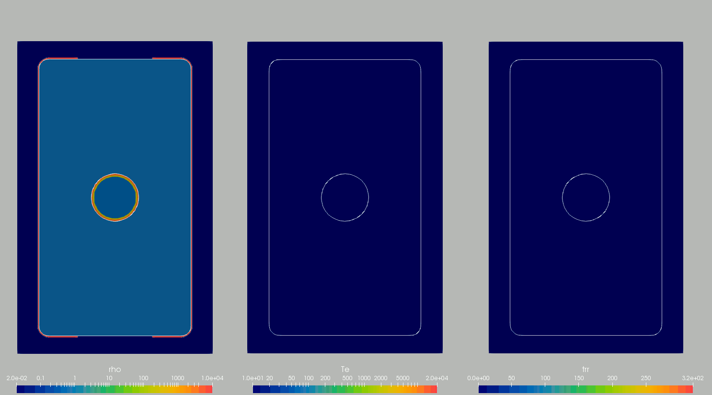
Context
Multi-physics code in 3D:
Magneto-hydrodynamics, radiation transport, thermal conduction, split electron-ion energy equations, laser ray trace, alpha particle transport, non-ideal equation of state, extended Ohm’s law, material strength…

Slide 5
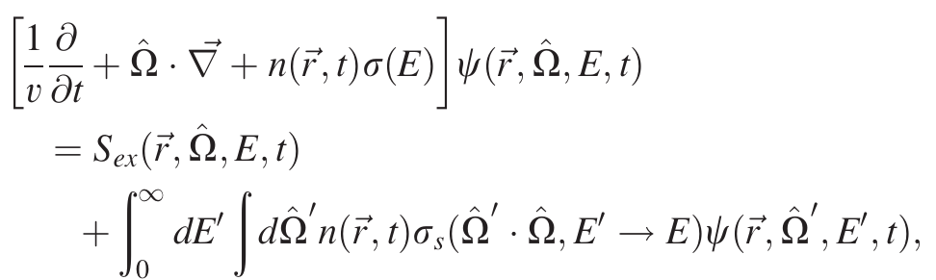
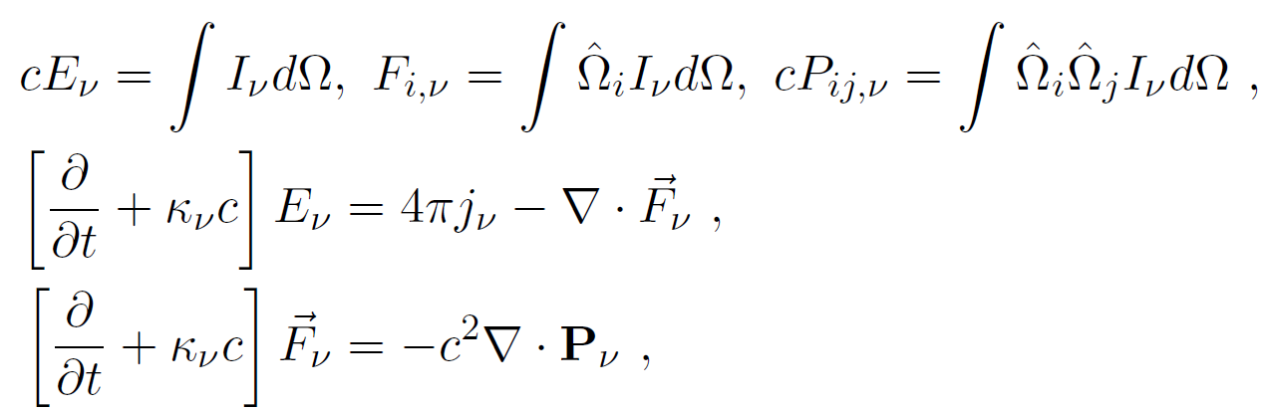
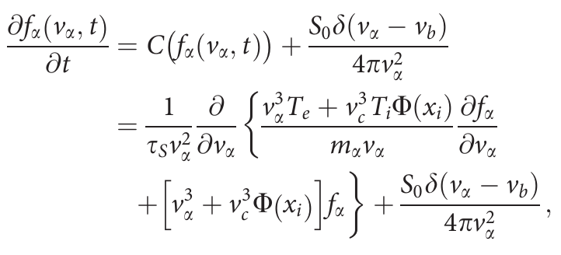
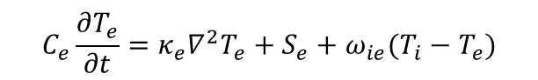

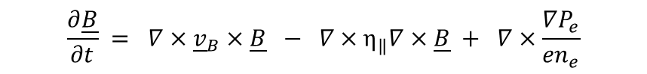
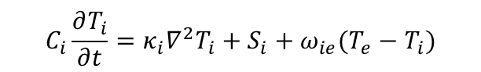
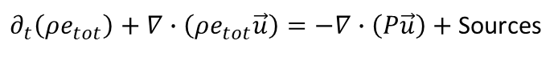
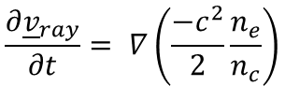
Context
Multi-physics code in 3D:
Magneto-hydrodynamics, radiation transport, thermal conduction, split electron-ion energy equations, laser ray trace, alpha particle transport, non-ideal equation of state, extended Ohm’s law, material strength…
$$∂_{t}ρ+∇∙\left(ρ\vec{u}\right) \text{= 0}$$
$$\frac{∂{\underline{v}}_{ray}}{∂t}= ∇\left(\frac{−c^{2}}{2}\frac{n_{e}}{n_{c}}\right)$$
$$∂_{t} \left(ρ\vec{u}\right)+∇∙\left(ρ\vec{u}\vec{u}\right)=−∇P+J×B$$
$∂_{t}\left(ρe_{tot}\right)+∇∙\left(ρe_{tot}\vec{u}\right)=−∇∙\left(P\vec{u}\right)+$Sources
$$\frac{∂\underline{B}}{∂t} = ∇×{\underline{v}}_{B}×\underline{B} − ∇×η_{‖}∇×\underline{B} + ∇×\frac{∇P_{e}}{{en}_{e}}$$
$$C_{e}\frac{∂T_{e}}{∂t}=κ_{e}∇^{2}T_{e}+S_{e}+ω_{ie}(T_{i}−T_{e})$$
$$C_{i}\frac{∂T_{i}}{∂t}=κ_{i}∇^{2}T_{i}+S_{i}+ω_{ie}(T_{e}−T_{i})$$
And the list goes on…

Slide 6
Numerical modelling
Concerned with the accurate solution of physical models
Physics-based models
- Handcrafted parameters
- Sim-to-reality gap
+ Learned parameters
+ Interpretable
+ Better capture data
Physical “guarantees”
(extrapolation, conservation, etc.)
Data-driven models
- Poor extrapolation
- Lack physical insight
Proximity to data

Slide 7
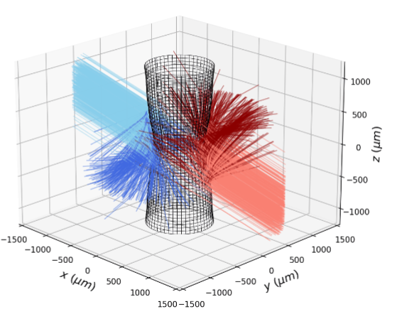
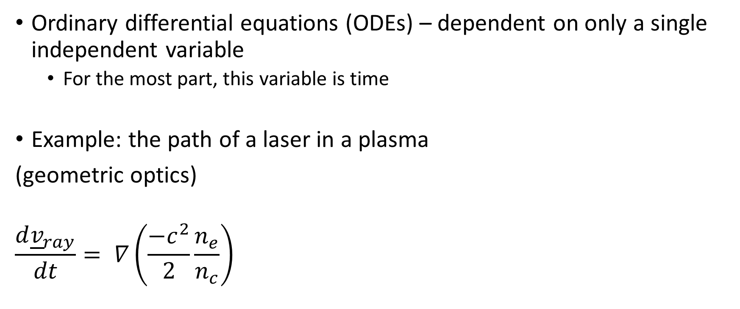
Numerical modelling – ODEs
Ordinary differential equations (ODEs) – dependent on only a single independent variable
For the most part, this variable is time
Example: the path of a laser in a plasma
(geometric optics)
$$\frac{d{\underline{v}}_{ray}}{dt}= ∇\left(\frac{−c^{2}}{2}\frac{n_{e}}{n_{c}}\right)$$

Slide 8
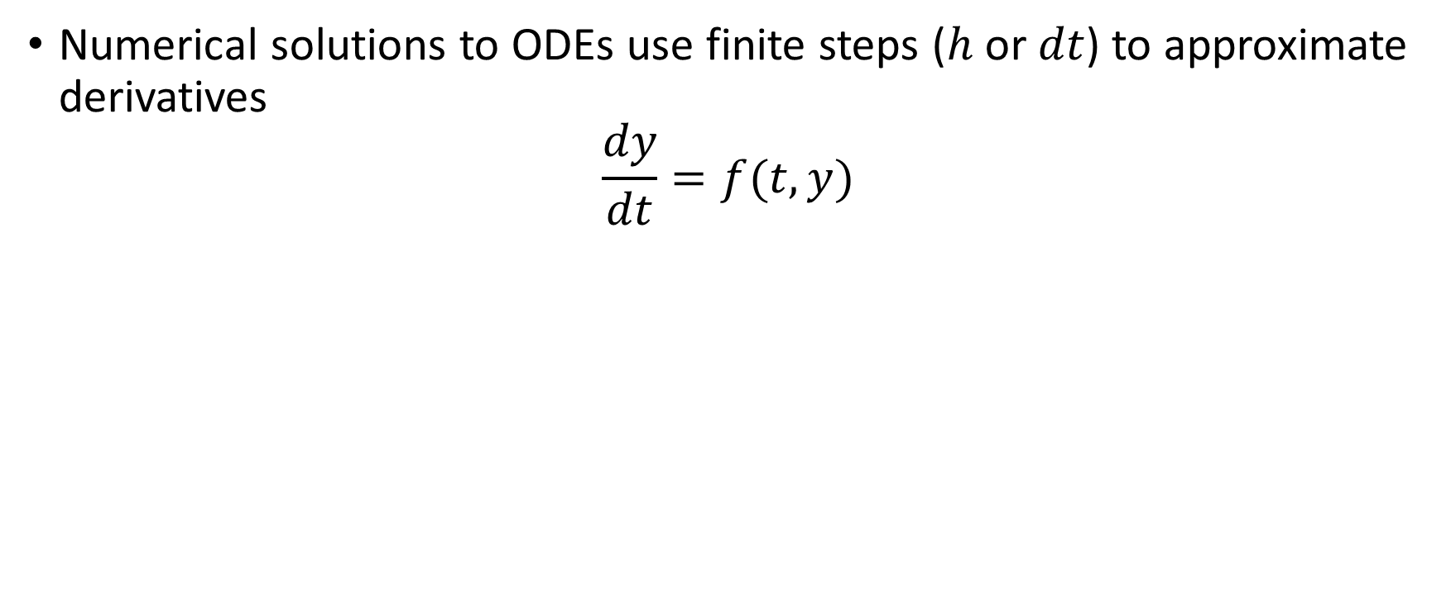
Numerical modelling – ODEs
Numerical solutions to ODEs use finite steps ($h$ or $dt$) to approximate derivatives
$$\frac{dy}{dt}=f(t,y)$$

Slide 9
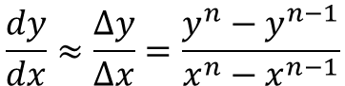
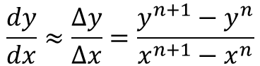
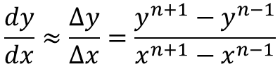
Numerical modelling – ODEs
We use finite differencing to approximate derivatives
Forward differencing:
Backward differencing:
Centred differencing:
$$\frac{dy}{dx}≈\frac{∆y}{∆x}=\frac{y^{n+1}−y^{n}}{x^{n+1}−x^{n}}$$
First order in accuracy
$$\frac{dy}{dx}≈\frac{∆y}{∆x}=\frac{y^{n}−y^{n−1}}{x^{n}−x^{n−1}}$$
$$\frac{dy}{dx}≈\frac{∆y}{∆x}=\frac{y^{n+1}−y^{n−1}}{x^{n+1}−x^{n−1}}$$
Second order in accuracy

Slide 10
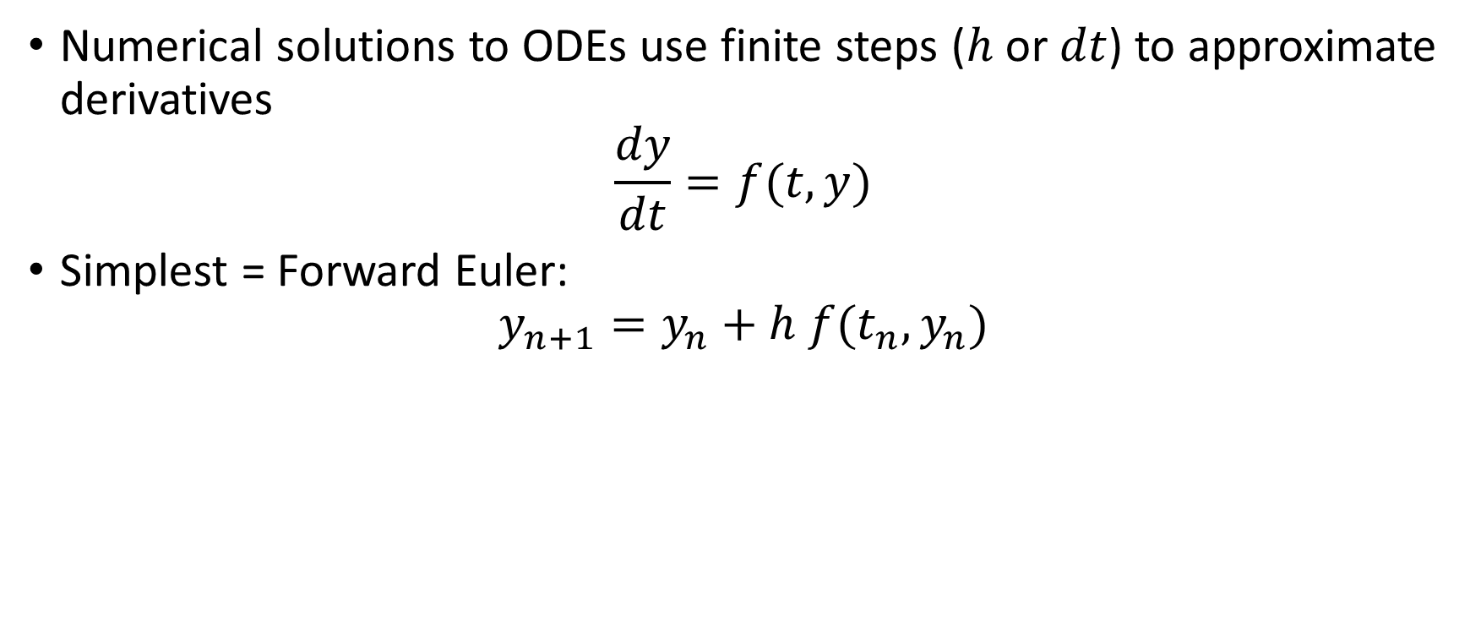
Numerical modelling – ODEs
Numerical solutions to ODEs use finite steps ($h$ or $dt$) to approximate derivatives
$$\frac{dy}{dt}=f(t,y)$$
Simplest = Forward Euler:
$$y_{n+1}=y_{n}+h f(t_{n},y_{n})$$

Slide 11
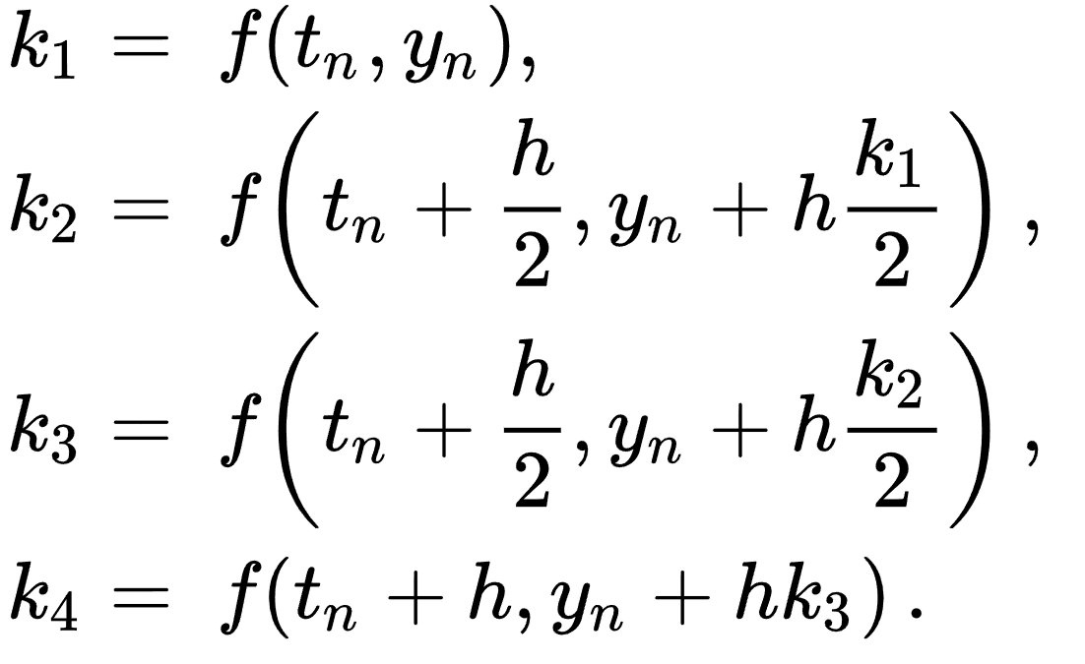
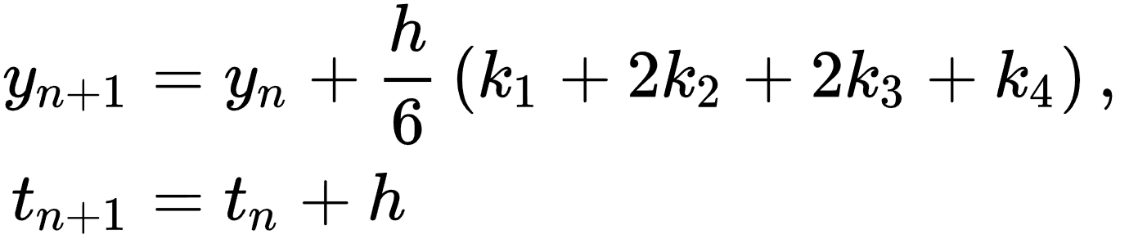
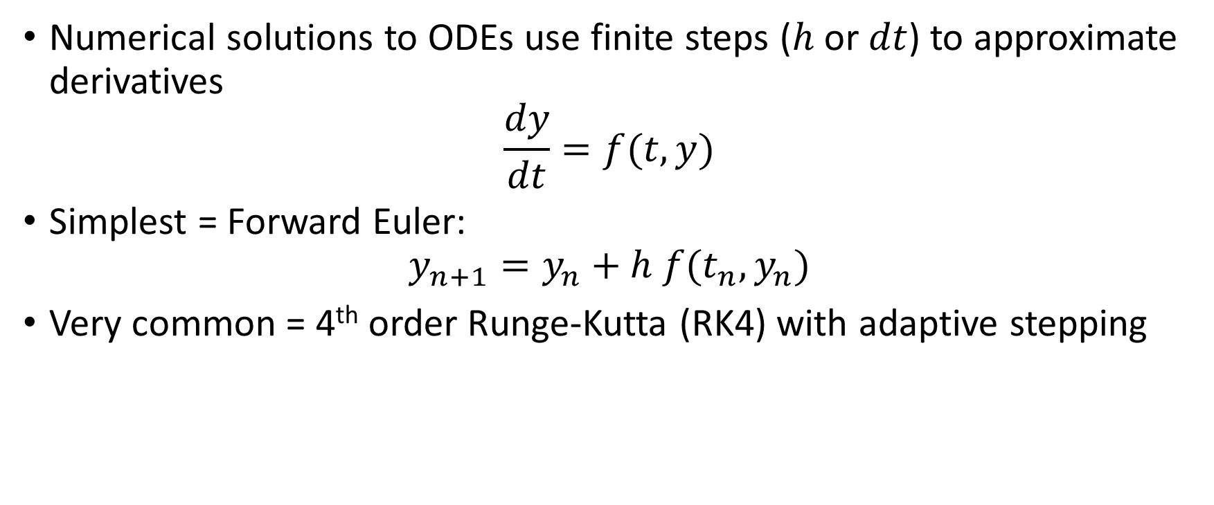
Numerical modelling – ODEs
Numerical solutions to ODEs use finite steps ($h$ or $dt$) to approximate derivatives
$$\frac{dy}{dt}=f(t,y)$$
Simplest = Forward Euler:
$$y_{n+1}=y_{n}+h f(t_{n},y_{n})$$
Very common = 4th order Runge-Kutta (RK4) with adaptive stepping

Slide 12
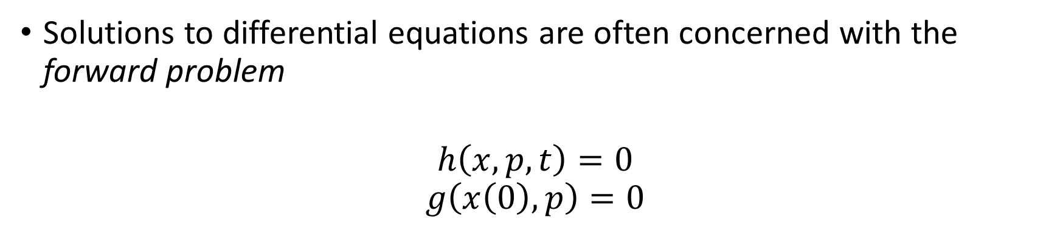
Forward vs Inverse problems
Solutions to differential equations are often concerned with the forward problem
$$h\left(x,p,t\right)=0$$
$$g\left(x\left(0\right),p\right)=0$$
x = state variables
p = parameters
t = time
Differential equation:
Initial condition:
Initial conditions:
Densities, temperatures, etc.
Differential equations:
Hydrodynamics ++
Other parameters: Laser power vs time

Slide 13
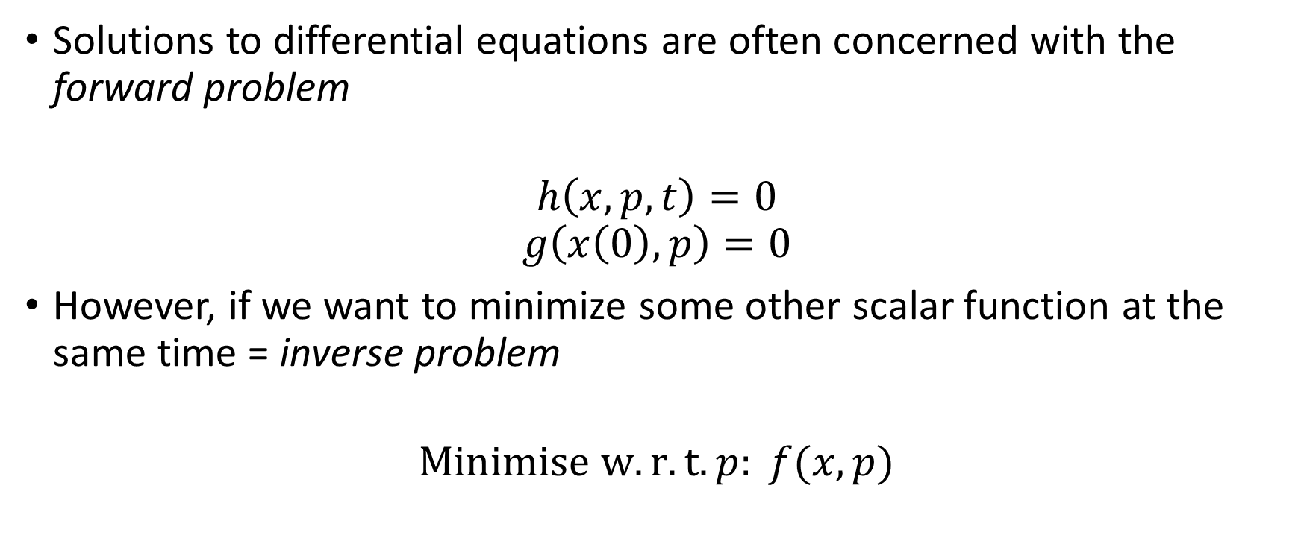
Forward vs Inverse problems
Solutions to differential equations are often concerned with the forward problem
$$h\left(x,p,t\right)=0$$
$$g\left(x\left(0\right),p\right)=0$$
However, if we want to minimize some other scalar function at the same time = inverse problem
$$Minimise w.r.t. p: f(x,p)$$
x = state variables
p = parameters
t = time
Differential equation:
Initial condition:
Figure of merit:

Slide 14
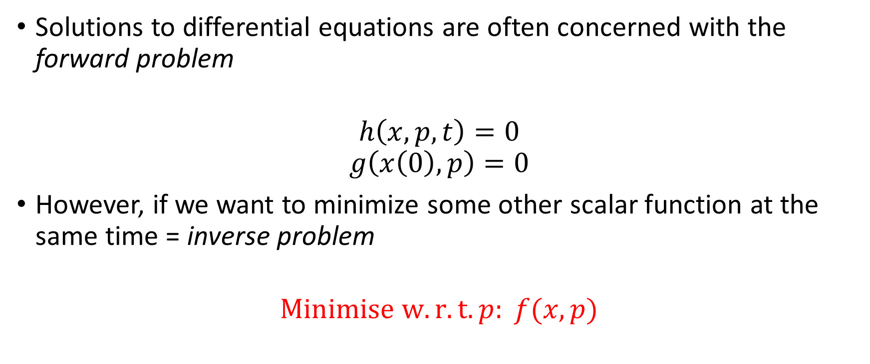
Forward vs Inverse problems
Solutions to differential equations are often concerned with the forward problem
$$h\left(x,p,t\right)=0$$
$$g\left(x\left(0\right),p\right)=0$$
However, if we want to minimize some other scalar function at the same time = inverse problem
$$Minimise w.r.t. p: f(x,p)$$
x = state variables
p = parameters
t = time
Differential equation:
Initial condition:
Figure of merit:
Optimisation

Slide 15
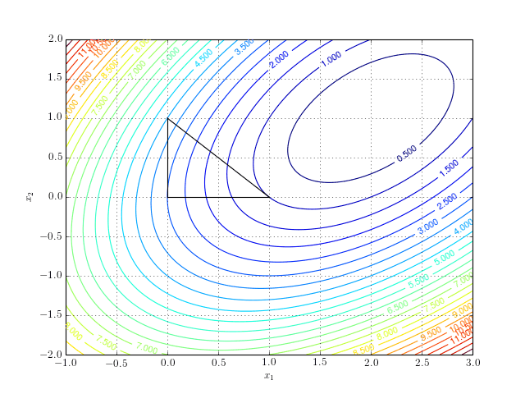
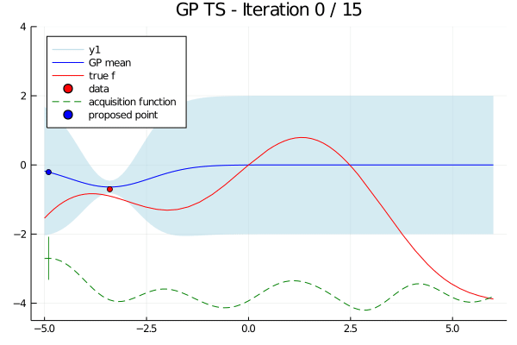
Optimisation
Minimisation = optimisation = root-finding of gradient
Gradient-based vs gradient-free optimisation
Gradient-free:
Downhill-simplex
Bayesian optimisation

Slide 16
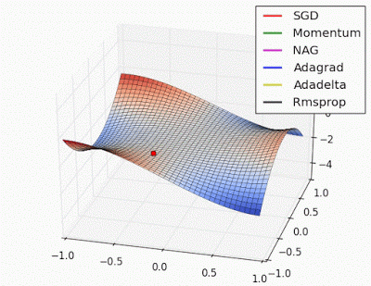
Optimisation
Minimisation = optimisation
Gradient-based:
Simple idea, roll down-hill (to minimize)
We will visit the mathematics later…

Slide 17
The adjoint state problem
How do we solve the inverse problem in differential equations efficiently?
We could run additional forward solutions to get finite difference gradients – very inefficient
Instead of predicting how a single design change influences every aspect of the flow, the adjoint method predicts how every design change influences a single aspect of the flow.

Slide 18

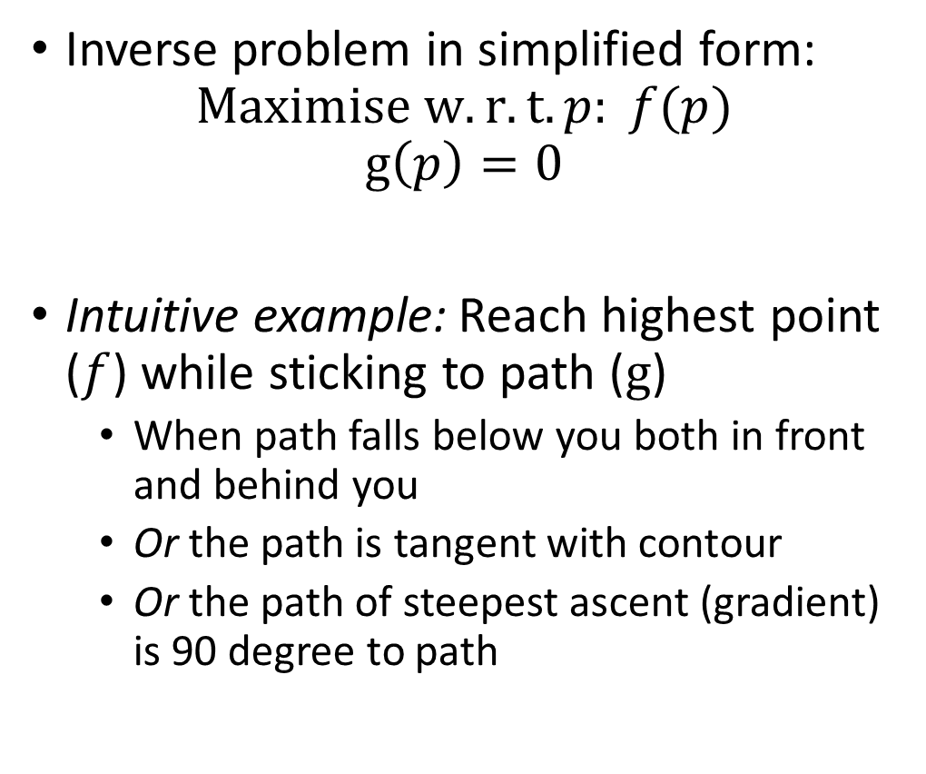
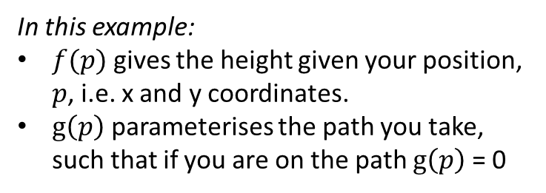
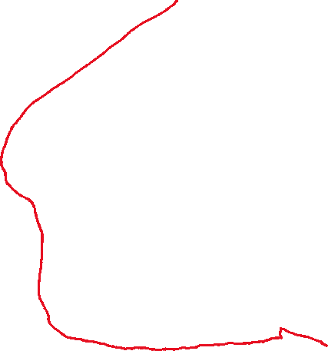
Constrained Optimisation
Inverse problem in simplified form:
$$Maximise w.r.t. p: f(p)$$
$$g\left(p\right)=0$$
Intuitive example: Reach highest point ($f$) while sticking to path ($g$)
When path falls below you both in front and behind you
Or the path is tangent with contour
Or the path of steepest ascent (gradient) is 90 degree to path
In this example:
$f(p)$ gives the height given your position, $p$, i.e. x and y coordinates.
$g\left(p\right)$ parameterises the path you take, such that if you are on the path $g\left(p\right)$ = 0

Slide 19
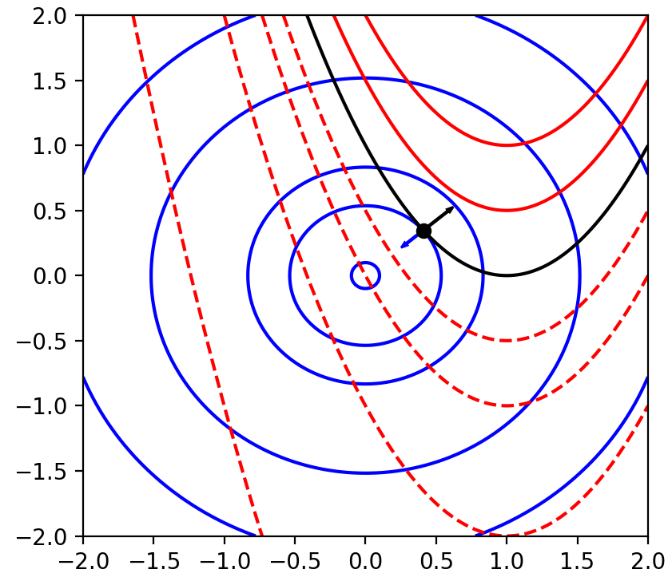
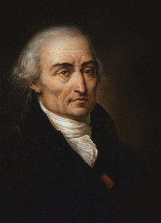
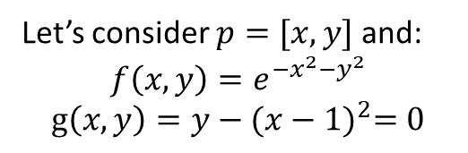
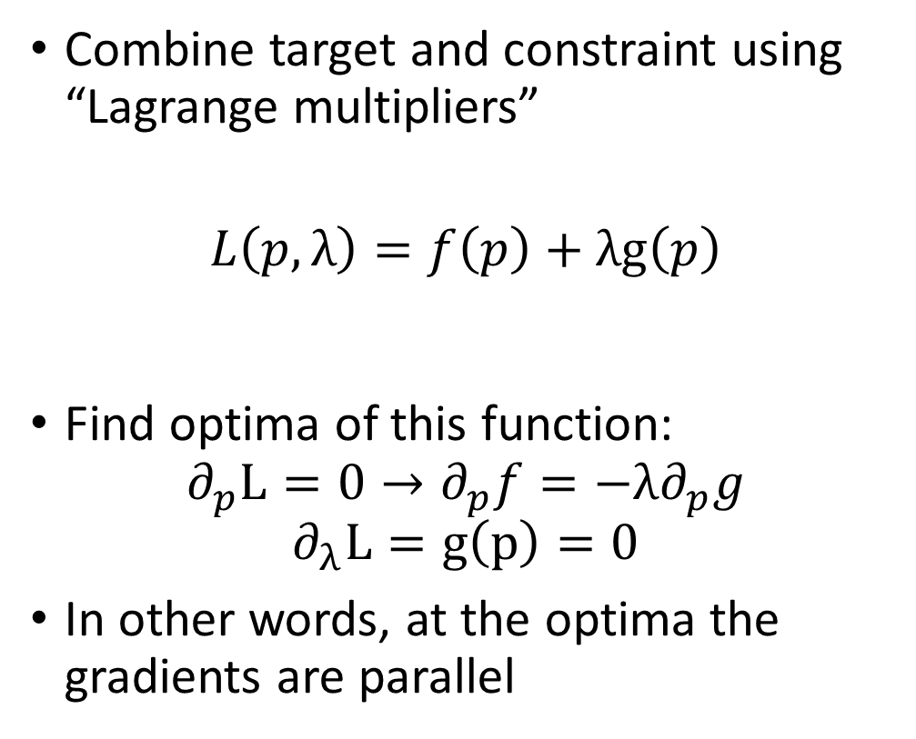
Constrained Optimisation – the maths
Let’s consider $p=[x,y]$ and:
$$f\left(x,y\right)=e^{−x^{2}−y^{2}}$$
$$g\left(x,y\right)=y−{(x−1)}^{2}=0$$
Combine target and constraint using “Lagrange multipliers”
$$L\left(p,λ\right)=f\left(p\right)+λg\left(p\right)$$
Find optima of this function:
$$∂_{p}L=0→∂_{p}f=−λ∂_{p}g$$
$$∂_{λ}L=g\left(p\right)=0$$
In other words, at the optima the gradients are parallel

Slide 20
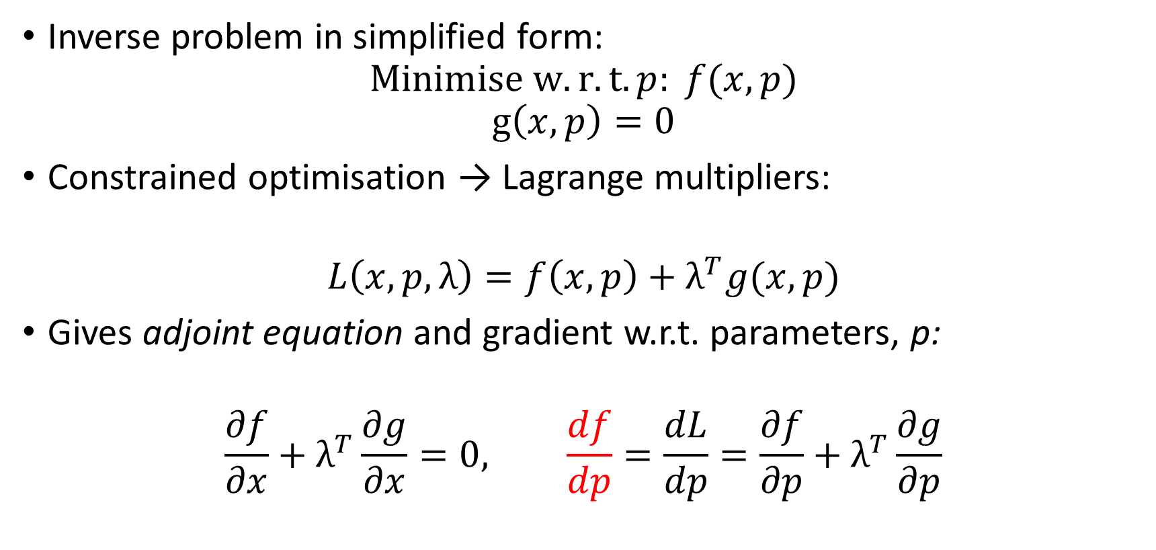
The adjoint state problem
Inverse problem in simplified form:
$$Minimise w.r.t. p: f(x,p)$$
$$g\left(x,p\right)=0$$
Constrained optimisation → Lagrange multipliers:
$$L\left(x,p,λ\right)=f\left(x,p\right)+λ^{T}g(x,p)$$
Gives adjoint equation and gradient w.r.t. parameters, p:
$$\frac{∂f}{∂x}+λ^{T}\frac{∂g}{∂x}=0, \frac{df}{dp}=\frac{dL}{dp}=\frac{∂f}{∂p}+λ^{T}\frac{∂g}{∂p}$$

Slide 21
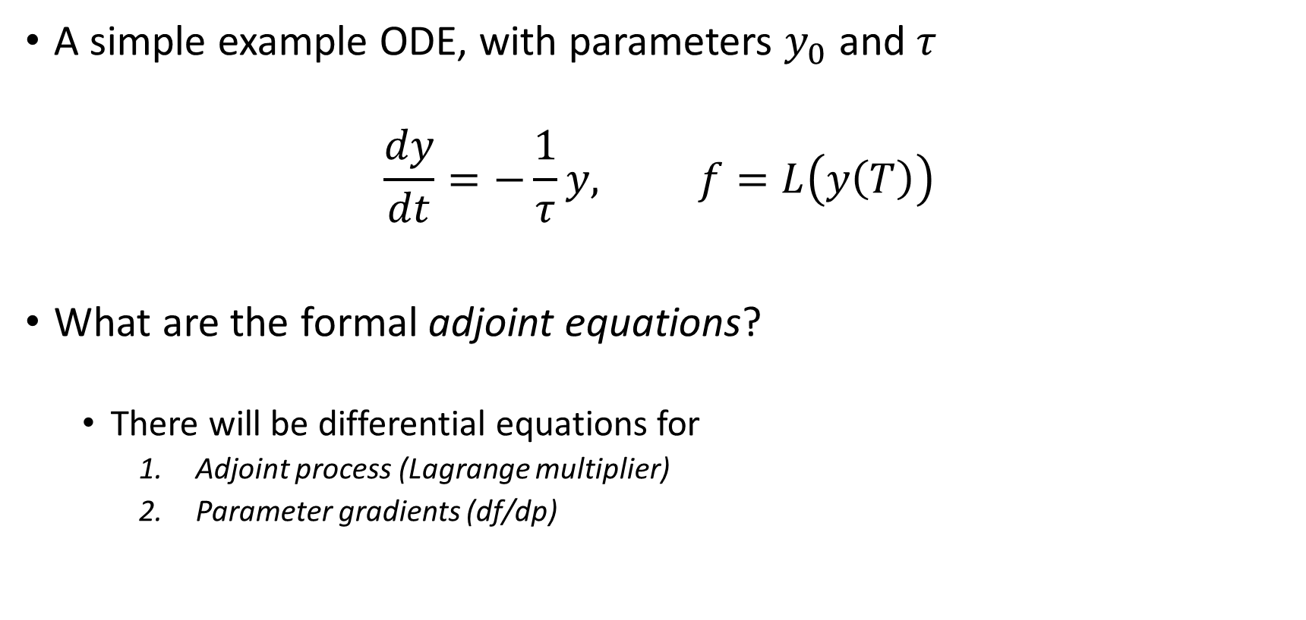
The adjoint state problem – for ODEs
A simple example ODE, with parameters $y_{0}$ and $τ$
$$\frac{dy}{dt}=−\frac{1}{τ}y, f=L\left(y\left(T\right)\right)$$
What are the formal adjoint equations?
There will be differential equations for
Adjoint process (Lagrange multiplier)
Parameter gradients (df/dp)

Slide 22
The adjoint state problem – for ODEs
To the whiteboard!

Slide 23
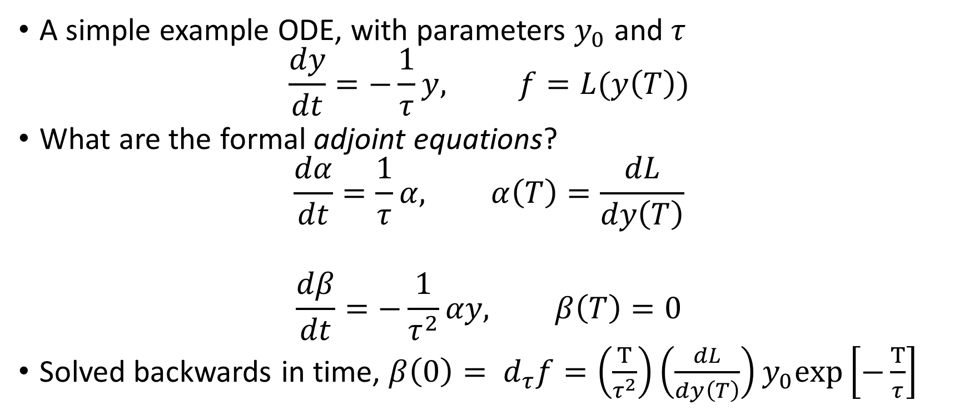
What if our function is a solution to an ODE?
A simple example ODE, with parameters $y_{0}$ and $τ$
$$\frac{dy}{dt}=−\frac{1}{τ}y, f=L(y\left(T\right))$$
What are the formal adjoint equations?
$$\frac{dα}{dt}=\frac{1}{τ}α, α\left(T\right)=\frac{dL}{dy\left(T\right)}$$
$$\frac{dβ}{dt}=−\frac{1}{τ^{2}}αy, β\left(T\right)=0$$
Solved backwards in time, $β\left(0\right)= d_{τ}f=\left(\frac{T}{τ^{2}}\right)\left(\frac{dL}{dy\left(T\right)}\right)y_{0}exp\left[−\frac{T}{τ}\right]$
Adjoint process:
Exponential growth
Parameter gradients:
Ref: https://proceedings.mlr.press/v144/ainsworth21a/ainsworth21a.pdf

Slide 24
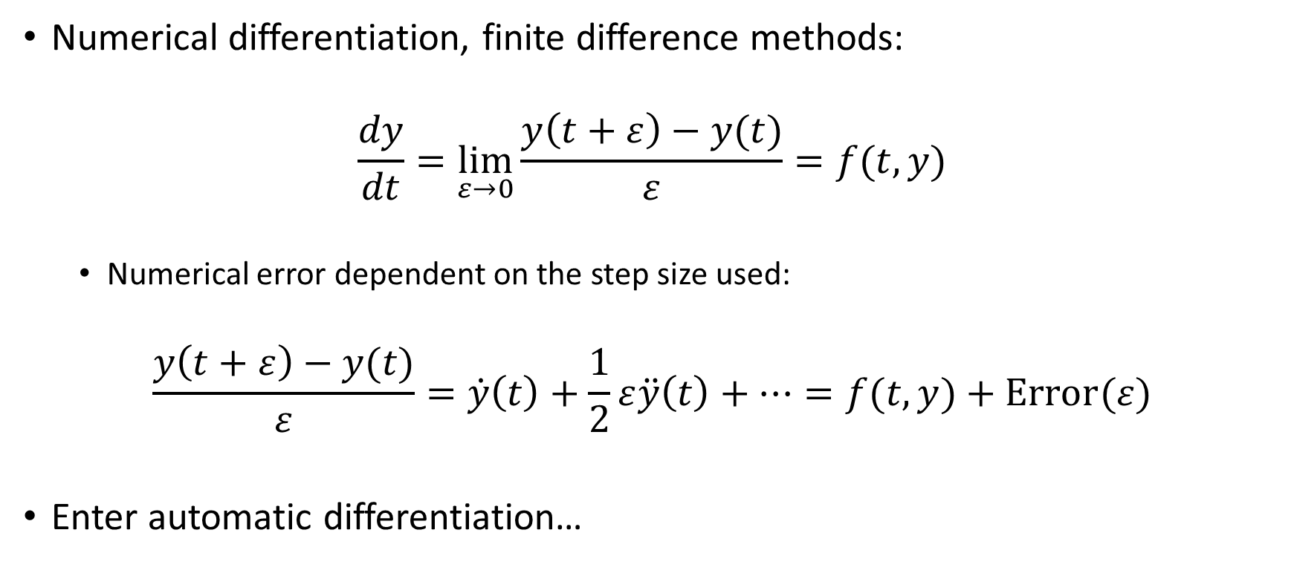
Automatic differentiation introduction
Numerical differentiation, finite difference methods:
$$\frac{dy}{dt}=\lim_{ε→0}{\frac{y\left(t+ε\right)−y(t)}{ε}}=f(t,y)$$
Numerical error dependent on the step size used:
$$\frac{y\left(t+ε\right)−y(t)}{ε}=\dot{y}\left(t\right)+\frac{1}{2}ε\ddot{y}\left(t\right)+…=f(t,y)+Error(ε)$$
Enter automatic differentiation…

Slide 25
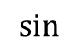


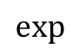

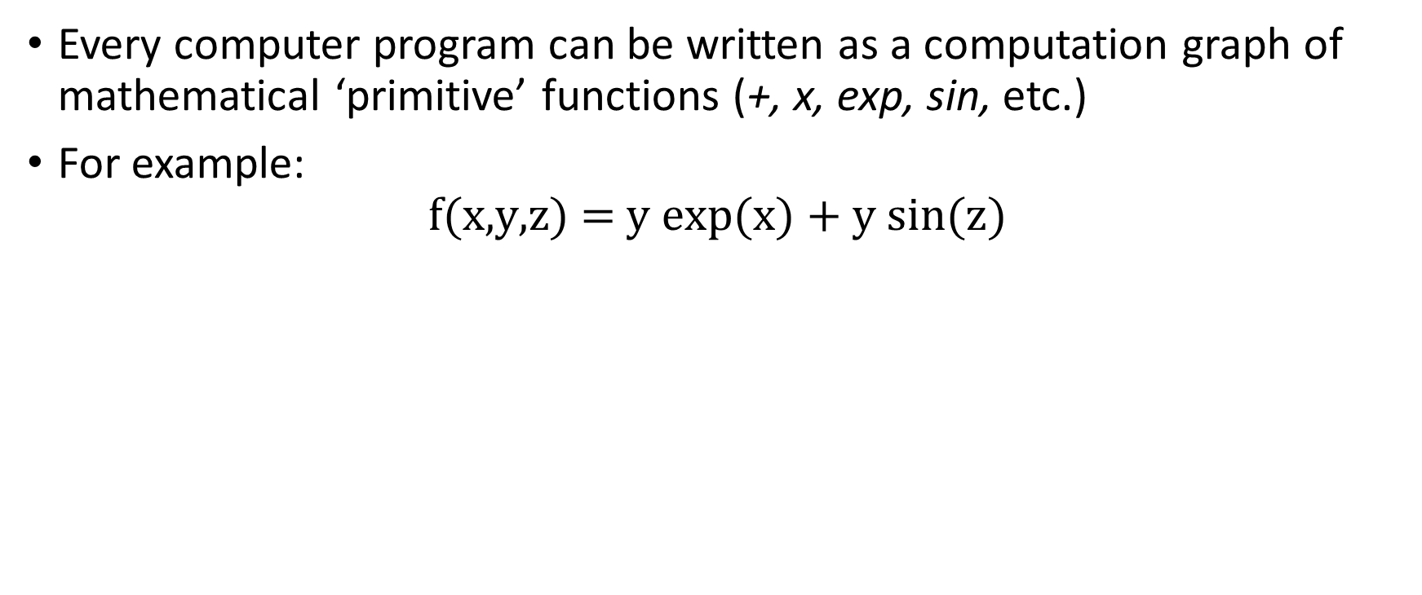
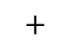


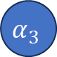


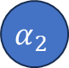


Automatic Differentiation Intro
Every computer program can be written as a computation graph of mathematical ‘primitive’ functions (+, x, exp, sin, etc.)
For example:
$$\text{f}\text{(}\text{x}\text{,}\text{y}\text{,}\text{z}\text{) = }\text{y} \text{exp}\text{(}\text{x}\text{) + }\text{y} \text{sin}\text{(}\text{z}\text{)}$$
x
$$α_{1}$$
$$\text{exp}$$
$$α_{4}$$
$$∗$$
$$α_{6}$$
$$+$$
y
$$α_{2}$$
$$α_{8}$$
$$f$$
$$∗$$
$$α_{7}$$
z
$$α_{3}$$
$$\text{sin}$$
$$α_{5}$$

Slide 26
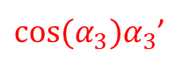

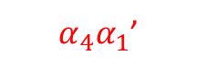
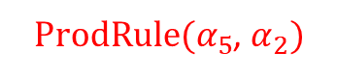
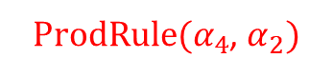
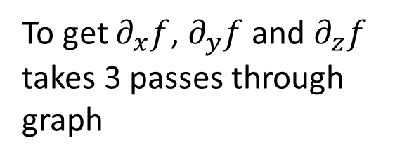
Automatic Differentiation Intro
Every computer program can be written as a computation graph of mathematical ‘primitive’ functions (+, x, exp, sin, etc.)
For example:
$$\text{f}\text{(}\text{x}\text{,}\text{y}\text{,}\text{z}\text{) = }\text{y} \text{exp}\text{(}\text{x}\text{) + }\text{y} \text{sin}\text{(}\text{z}\text{)}$$
x
$$α_{1}$$
$$\text{exp}$$
$$α_{4}$$
$$∗$$
$α_{4}α_{1}$’
$$α_{6}$$
$$+$$
y
$$α_{2}$$
$ProdRule(α_{4}$, $α_{2})$
$$α_{8}$$
$$f$$
$$∗$$
$$α_{7}$$
$α_{6}^{′}+$ $α_{7}$’
z
$$α_{3}$$
$$\text{sin}$$
$$α_{5}$$
$ProdRule(α_{5}$, $α_{2})$
To get $∂_{x}f$, $∂_{y}f$ and $∂_{z}f$ takes 3 passes through graph
$\text{c}\text{os}\text{(}α_{3})α_{3}$’
“Forward mode” automatic differentiation

Slide 27
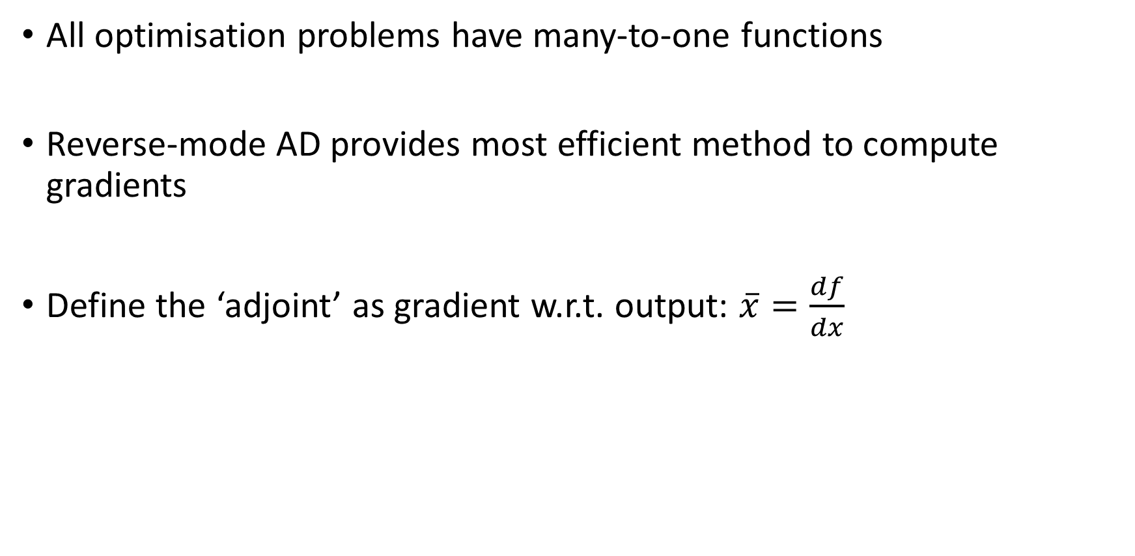
Automatic Differentiation Intro
All optimisation problems have many-to-one functions
Reverse-mode AD provides most efficient method to compute gradients
Define the ‘adjoint’ as gradient w.r.t. output: $\overline{x}=\frac{df}{dx}$

Slide 28


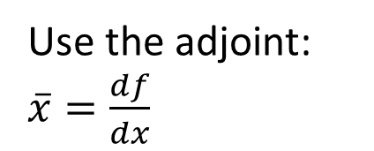
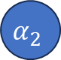













Automatic Differentiation Intro
In our example:
Use the adjoint: $\overline{x}=\frac{df}{dx}$
x
$$α_{1}$$
$$\text{exp}$$
$$α_{4}$$
$$∗$$
$$α_{6}$$
$$+$$
y
$$α_{2}$$
$$α_{8}$$
$$f$$
$$∗$$
$$α_{7}$$
$$\overline{α_{8}}=1$$
z
$$α_{3}$$
$$\text{sin}$$
$$α_{5}$$
$$\overline{α_{7}}=\frac{∂α_{8}}{∂α_{7}}\overline{α_{8}}=\overline{α_{8}}=1$$
Chain rule

Slide 29





Automatic Differentiation Intro
In our example:
$$\overline{α_{1}}=α_{4}\overline{α_{4}}=α_{2}α_{4}$$
$$\overline{α_{4}}=α_{2}\overline{α_{6}}=α_{2}$$
x
$$α_{1}$$
$$\text{exp}$$
$$α_{4}$$
$$\overline{α_{6}}=\overline{α_{8}}=1$$
$$∗$$
$$\overline{α_{2}}=α_{4}\overline{α_{6}}+α_{5}\overline{α_{7}}=α_{4}+α_{5}$$
$$α_{6}$$
$$+$$
y
$$α_{2}$$
$$α_{8}$$
$$f$$
$$∗$$
$$α_{7}$$
$$\overline{α_{8}}=1$$
z
$$α_{3}$$
$$\text{sin}$$
$$α_{5}$$
$$\overline{α_{7}}=\frac{∂α_{8}}{∂α_{7}}\overline{α_{8}}=\overline{α_{8}}=1$$
$$\overline{α_{3}}=cos(α_{3})\overline{α_{5}}=α_{2}cos(α_{3})$$
$$\overline{α_{5}}=α_{2}\overline{α_{7}}=α_{2}$$
A single ‘back-propagation’ gives all gradients!

Slide 30

Differentiable Programming?
Yann LeCun:
“Deep Learning est mort. Vive Differentiable Programming!
…
An increasingly large number of people are defining the networks procedurally in a data-dependent way (with loops and conditionals), allowing them to change dynamically as a function of the input data fed to them. It's really very much like a regular program, except it's parameterized, automatically differentiated, and trainable/optimizable. Dynamic networks have become increasingly popular…”

Slide 31
Automatic-differentiation/differentiable-programming frameworks
Python: PyTorch – autograd
Python: Tensorflow – GradientTape
Python: JAX
C++: autodiff
Check out autodiff.org for other languages/libraries

Slide 32












What if our function is a solution to an ODE?
A simple example ODE, solved using Euler’s method
$$\frac{dy}{dt}=−\frac{1}{τ}y, y_{n+1}=\left(1−\frac{dt}{τ}\right)y_{n}=δy_{n}$$
Define some loss, $\text{f}$, which uses values of y
It’s just a graph
We can compute $d_{τ}\text{f}$, $d_{dt}\text{f}$ and $d_{y_{0}}\text{f}$ using back-propagation
$$y_{0}$$
$$y_{1}$$
$$y_{2}$$
…
$$y_{N}$$
$$∗$$
$$∗$$
$$∗$$
$$τ$$
$$δ$$
$$\text{f}$$
dt

Slide 33
What if our function is a solution to an ODE?
A simple example ODE, with parameters $y_{0}$ and $τ$
$$\frac{dy}{dt}=−\frac{1}{τ}y, f=L(y\left(T\right))$$
What are the formal adjoint equations?
$$\frac{dα}{dt}=\frac{1}{τ}α, α\left(T\right)=\frac{dL}{dy\left(T\right)}$$
$$\frac{dβ}{dt}=−\frac{1}{τ^{2}}αy, β\left(T\right)=0$$
Solved backwards in time, $β\left(0\right)= d_{τ}f=\left(\frac{T}{τ^{2}}\right)\left(\frac{dL}{dy\left(T\right)}\right)y_{0}exp\left[−\frac{T}{τ}\right]$
Adjoint process:
Exponential growth
Parameter gradients:
Ref: https://proceedings.mlr.press/v144/ainsworth21a/ainsworth21a.pdf

Slide 34











What if our function is a solution to an ODE?
$$y_{0}$$
$$y_{1}$$
$$y_{2}$$
…
$$y_{N}$$
$$∗$$
$$∗$$
$$∗$$
$$τ$$
$$δ$$
$$\text{f}$$
$$y_{N}=\left(1−\frac{dt}{τ}\right)y_{N−1},$$
Backpropagation a single step:
$$\frac{df}{dτ}=\frac{dL}{dy_{N}}∙\frac{dy_{N}}{dτ}$$
$$\frac{dy_{N}}{dτ}=\frac{d}{dτ}\left[\left(1−\frac{dt}{τ}\right)y_{N−1}\right]$$
dt

Slide 35

What if our function is a solution to an ODE?
$$y_{0}$$
$$y_{1}$$
$$y_{2}$$
…
$$y_{N}$$
$$∗$$
$$∗$$
$$∗$$
$$τ$$
$$δ$$
$$\text{f}$$
$$y_{N}=\left(1−\frac{dt}{τ}\right)y_{N−1},$$
Backpropagation a single step:
$$\frac{df}{dτ}=\frac{dL}{dy_{N}}∙\frac{dy_{N}}{dτ}=\frac{dL}{dy_{N}}∙\left(\frac{dt}{τ^{2}}y_{N−1}+\left(1−\frac{dt}{τ}\right)\frac{dy_{N−1}}{dτ}\right)$$
dt

Slide 36

What if our function is a solution to an ODE?
$$y_{0}$$
$$y_{1}$$
$$y_{2}$$
…
$$y_{N}$$
$$∗$$
$$∗$$
$$∗$$
$$τ$$
$$y_{n}={\left(1−\frac{dt}{τ}\right)}^{n}y_{0},$$
Backpropagation all the way:
$$\frac{df}{dτ}=\frac{T}{τ^{2}}\frac{dL}{dy_{N}}y_{0}{\left(1−\frac{T}{Nτ}\right)}^{N−1}, T=Ndt$$
$$β\left(0\right)=\frac{T}{τ^{2}}\frac{dL}{dy(T)}y_{0}exp\left[−\frac{T}{τ}\right]$$
$$δ$$
$$\text{f}$$
dt
AD + ODE:
Backprop of ODE solution numerically solves adjoint state method
= “discretise-then-optimise”
Analytic adjoint state method:

Slide 37





























Extending the computational graph
Solving 3 ODEs with shared time step and method
$$y_{0}$$
$$y_{1}$$
$$y_{2}$$
…
$$y_{N}$$
$$∗$$
$$∗$$
$$∗$$
$$τ$$
$$δ$$
$$\text{f}$$
dt
$$\frac{dL}{dy\left(T\right)}$$
$$τ^{2}$$
$$α_{0}$$
$$α_{1}$$
$$α_{2}$$
…
$$α_{N}$$
$$ε$$
$$∗$$
$$∗$$
$$∗$$
Etc.
$$β_{0}$$
$$β_{1}$$
$$β_{2}$$
…
$$β_{N}$$
$$0$$
$$∗$$
$$∗$$
$$∗$$

Slide 38








An abstraction
$$y_{0}$$
Solve:
$$\frac{dy}{dt}=−\frac{1}{τ}y$$
$$\text{f}$$
Required y values needed by adjoint solution
$$τ$$
$$\frac{dL}{dy\left(T\right)}$$
Solve:
$$\frac{dα}{dt}=\frac{1}{τ}α,$$
$$\frac{dβ}{dt}=−\frac{1}{τ^{2}}αy$$
$$β_{0}$$
$$0$$

Slide 39



Numerical modelling – PDEs
Partial differential equations (PDEs) – dependent on only many independent variables
For the most part, these variables are space and time
Total derivative vs. partial derivative
$$\frac{d}{dt}\left[f(x,t)\right]=\frac{∂f}{∂t}+\frac{∂x}{∂t}∙\frac{∂f}{∂x}=\frac{∂f}{∂t}+v_{x}∙\frac{∂f}{∂x}$$
Example: Hydrodynamics

Slide 40










What if our function is a solution to a PDE?
Spatial discretisation makes time-space PDEs into time ODEs
Explicit time-stepping easiest:
$$\frac{dy}{dt}=L\left(y,θ\right) \underset{→}{\text{discretise}} y_{n+1}=\left(\underline{1}−\underline{L}(y_{n},θ)dt\right)y_{n}={\underline{A}}_{n}y_{n}$$
Initial conditions
We can modify our initial conditions or our model parameters to minimise the loss
$$y_{0}$$
$$y_{1}$$
$$y_{2}$$
…
$$y_{N}$$
$$A_{0}$$
$$A_{1}$$
$$A_{2}$$
…
$$\text{ℒ}$$
Model parameters
$$θ$$

Slide 41
Recipe for differentiable solver
Specify your ODE/PDE
Choose spatial (and temporal) differencing scheme
Define loss term for optimisation purposes
Compute adjoint system via ‘discretise-then-optimise’ or ‘optimise-then-discretise’ strategies

Slide 42
ODE differentiable programming libraries
Diffrax – JAX-based library providing numerical differential equation solvers
SciMLSensitivity.jl – Julia-based library, AD and adjoints for differential equations solvers (and more…)

Slide 43

Diffrax example
Diffrax has 4 key features (for our purposes):
Terms
Solvers
Adaptive stepping
Adjoints

Slide 44

Diffrax example
Diffrax has 4 key features (for our purposes):
Terms
Solvers
Adaptive stepping
Adjoints

Slide 45

Neural Differential Equations
Ref: On Neural Differential Equations, P. Kidger, Thesis
What if what to describe a dynamical system but don’t know the form of (some of) the terms?
$$\frac{dy}{dt}=L\left(t,y\right)+N_{θ}(t,y)$$
Neural network parameters learnt using adjoint state method
Known operations
Unknown operations – neural network

Slide 46


Physics Informed Neural Networks (PINNs)
Ref: Physics-informed neural networks…, Raissi, J. Comp. Phys., 2018
What if we know some physical law we want our NN to respect?
PINN = NN learns (approximate) solution to PDE/ODE:
$$y_{NN}(x,t)→y(x,t)$$
$$g_{PDE}≔ \frac{∂y}{∂t}+f\left(y;x,t\right)=0$$
Include a loss term which ensure $g_{PDE}$ is (approximately) respected:
$$L=L_{y}+L_{g}$$
Want to train NN $y_{NN}(x,t)$ to match some data while respecting physical law $g_{PDE}$ (or boundary condition)

Slide 47


Physics Informed Neural Networks
For example, diffusion:
$$y_{NN}(x,t)→y(x,t)$$
$$g_{PDE}≔ \frac{∂y}{∂t}−D\frac{∂^{2}y}{∂x^{2}}=0$$
$$L=\frac{1}{N}\sum{{\left(y_{NN}−y\right)}^{2}}+\frac{1}{N}\sum{{\left(\frac{∂y_{NN}}{∂t}−D\frac{∂^{2}y_{NN}}{∂x^{2}}\right)}^{2}}$$
Computed using automatic differentiation of NN

Slide 48
Neural Differential Equations (NDEs) vs Physics Informed Neural Networks (PINNs)
NDEs: Learning dynamics from data
Data-driven learning of unknown dynamics
PINNs: Learning solutions which obey physical laws
Fit to sparse data with known physics-based constraint

Slide 49
Colab Exercise
Diffrax library for solving ODEs
Neural Differential Equations
Physics Informed Neural Networks

Slide 50
Projects
Neural Differential Equations:
“Neural Ordinary Differential Equations for Chaotic System (Double Pendulum)”
Physics Informed Neural Networks:
“Physics Informed Neural Networks for Non-Linear Poisson Equation (Thomas Fermi Equation)”

